Slide 1
Basic Concepts (Revision of OS and Networking concepts)
Prepared By:
Avita Katal
Assistant Professor(SS)
Systemics Cluster
School of Computer Science
University of Petroleum and Energy Studies

Slide 2
Some Important Terms
Computer
Computer System
Some important terms
Multi Programming
Multi Tasking
Multi Processing
Multi Threading
4. Network

Slide 3
1. Computer
A computer is an electronic device, operating under the control of instructions (software) stored in its own memory unit, that can accept data (input), manipulate data (process), and produce information (output) from the processing. Generally, the term is used to describe a collection of devices that function together as a system.
A computer consists of three primary units:
Input units – accept data
Processor unit – processes data by performing comparisons and calculations
Output units – present the results

Slide 4



COMPUTER
MONITOR
PROCESSOR
KEYBOARD
Storage devices
PRINTER

Slide 5



1.1. Input Devices
Data are facts, numbers and characters that are entered into the computer via keyboard.
Other types of input devices are mouse, joystick, light pens, scanners, camera, etc.

Slide 6



1.1.Computer Input Devices
Keyboard
Mouse/Trackball
Joystick
Light pen
Pointing Stick
Touchpad
Touch screen
Bar code reader
Scanner
Microphone
Graphics Tablet
Digital Cameras

Slide 7

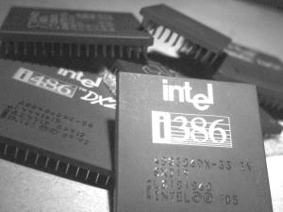
1.2. Processor Unit
Two main parts:
CPU – where the actual processing takes place; and
Main memory – where data are stored.
The contents of main memory can be transferred to auxiliary storage devices such as hard disks, floppy diskettes, zip disks, compact disks, or USB flash disk.

Slide 8

1.2. Central Processing Unit
The microprocessor, the brains of the computer. Referred to a CPU or processor.
Housed on a tiny silicon chip
Chip contains millions of switches and pathways that help your computer make important decisions.
CPU knows which switches to turn on and which to turn off because it receives its instructions from computer programs (software).
CPU has two primary sections:
Arithmetic/logic unit
Control unit

Slide 9
1.2.1. Arithmetic Logic UNIT(ALU)
Performs arithmetic computations and logical operations; by combining these two operations the ALU can execute complex tasks.
- Arithmetic operations include addition, subtractions, multiplication, and division.
- Logical operations involve comparisons.

Slide 10
1.2.2. Control UNIT(Cu)
Control Unit: is the “boss” and coordinates all of the CPU’s activities.
Uses programming instructions, it controls the flow of information through the processor by controlling what happens inside the processor.
We communicate with the computer through programming languages.
Examples: COBOL, C++, HTML, Java Script or VisualBasic.net

Slide 11

1.3. Memory
Found on the motherboard
Short term
Random Access Memory (RAM)
Long term
Read Only Memory (ROM)

Slide 12
1.3.1. Random Access Memory(ram)
Memory on the motherboard that is short term; where data, information, and program instructions are stored temporarily on a RAM chip or a set of RAM chips. Known as the main memory.
This memory is considered volatile.
When the computer is turned off or if there is loss of power, what ever is stored in RAM disappears. “Temporary Memory” – Short Term
The computer can read from and write to RAM.

Slide 13
1.3. 2. Read only Memory(rom)
Memory on the motherboard that is long term; where the specific instructions that are needed for the computer to operate are stored.
This memory is nonvolatile and your computer can only read from a ROM chip.
The instructions remain on the chip regardless if the power is turned on or off.
Most common is the BIOS ROM; where the computer uses instructions contained on this chip to boot or start the system when you turn on your computer.
“Permanent Memory” – Long Term

Slide 14
1.4. Output Unit
After the data has been processed, the results are output in the form of useful information.
Output units such as monitors and printers make the result accessible for use by people
Examples.
Monitor: screen that display information such as text, numbers, and pictures-softcopy.
Printer: gives you information from the computer in printed form – hardcopy
Speakers: allow you to hear voice, music, and other sounds from your computer.
Modem: allows you to use your computer to communicate with other computers.

Slide 15
2. Computer SYSTEM
Hardware + Software
Bringing the Machine to Life – What is Software?
Software is a set of electronic instructions that tells the computer how to do certain tasks. A set of instructions is often called a program.
When a computer is using a particular program, it is said to be running or executing the program.
The two most common types of programs are System software and Application software.

Slide 16
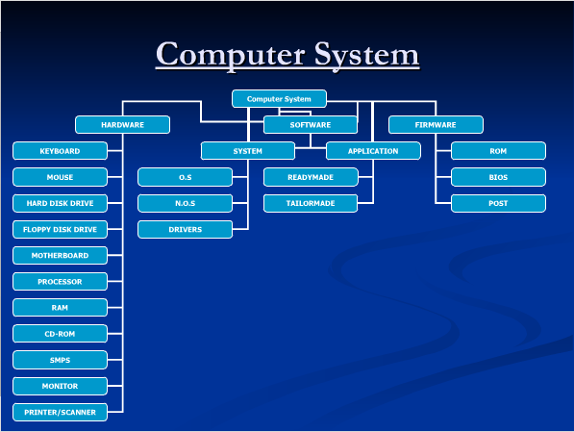

Slide 17
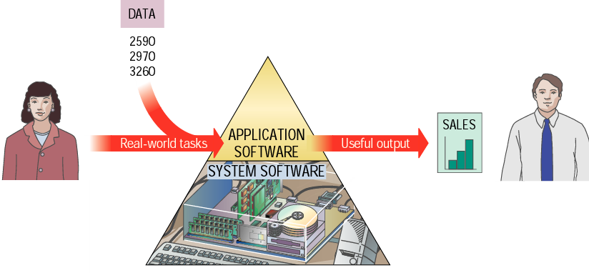

Slide 18
2.1 SYSTEM Software
System software exists primarily for the computer itself, to help the computer perform specific functions.
One major type of system software is the operating system (OS). All computers require an operating system.
The OS tells the computer how to interact with the user and its own devices.
Common operating systems include Windows, the Macintosh OS, OS/2, and UNIX .

Slide 19
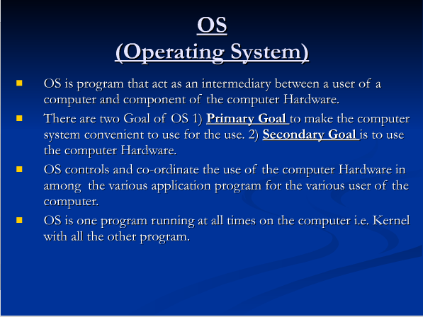
2.1.1 Operating system

Slide 20
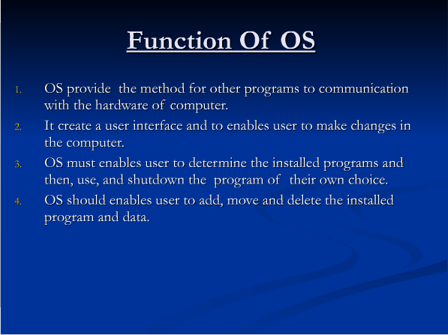
2.1.1 Operating system

Slide 21
2.2 application Software
Application Software consists of programs that tell a computer how to produce information
Application software tells the computer how to accomplish tasks the user requires, such as creating a document or editing a graphic image.
Some important kinds of application software are:
Word processing programs Spreadsheet software
Database management Presentation programs
Graphics programs Networking software
Web design tools and browsers Internet applications
Communications programs Utilities
Entertainment and education Multimedia authoring

Slide 22
2.3. Firmware
Firmware are programs that are permanently written and stored in memory

Slide 23
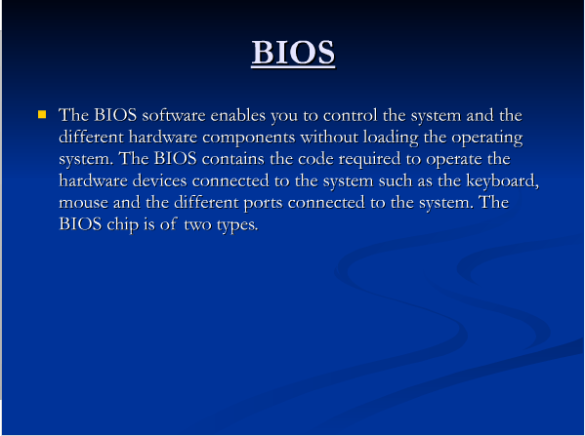
2.3.1. BIOS

Slide 24
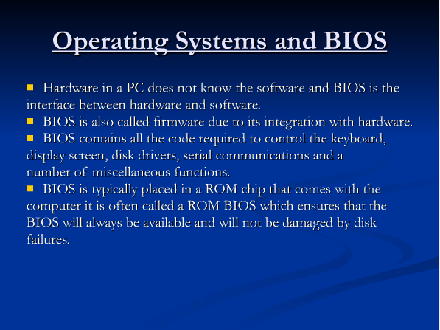
2.3.1. BIOS

Slide 25
3. Important Terms

Slide 26
3.1. Multi programming
In a multiprogramming system there are one or more programs loaded in main memory which are ready to execute.
Only one program at a time is able to get the CPU for executing its instructions (i.e., there is at most one process running on the system) while all the others are waiting their turn.
The main idea of multiprogramming is to maximize the use of CPU time.
Note that in order for such a system to function properly, the OS must be able to load multiple programs into separate areas of the main memory and provide the required protection to avoid the chance of one process being modified by another one.
Finally, note that if there are N ready processes and all of those are highly CPU-bound (i.e., they mostly execute CPU tasks and none or very few I/O operations), in the very worst case one program might wait all the other N-1 ones to complete before executing.

Slide 27
3.2. Multi Tasking
Multitasking has the same meaning of multiprogramming but in a more general sense, as it refers to having multiple (programs, processes, tasks, threads) running at the same time.
This term is used in modern operating systems when multiple tasks share a common processing resource (e.g., CPU and Memory). At any time the CPU is executing one task only while other tasks waiting their turn.
The illusion of parallelism is achieved when the CPU is reassigned to another task (i.e. process or thread context switching).
There are subtle differences between multitasking and multiprogramming.
A task in a multitasking operating system is not a whole application program but it can also refer to a “thread of execution” when one process is divided into sub-tasks.
Each smaller task does not hijack the CPU until it finishes like in the older multiprogramming but rather a fair share amount of the CPU time called quantum.
Just to make it easy to remember, both multiprogramming and multitasking operating systems are (CPU) time sharing systems. However, while in multiprogramming (older OSs) one program as a whole keeps running until it blocks, in multitasking (modern OSs) time sharing is best manifested because each running process takes only a fair quantum of the CPU time.

Slide 28
3.3. Multi Processing
Multiprocessing sometimes refers to executing multiple processes (programs) at the same time. This might be misleading because we have already introduced the term “multiprogramming” to describe that before.
In fact, multiprocessing refers to the hardware (i.e., the CPU units) rather than the software (i.e., running processes). If the underlying hardware provides more than one processor then that is multiprocessing.
Several variations on the basic scheme exist, e.g., multiple cores on one die or multiple dies in one package or multiple packages in one system.
Anyway, a system can be both multiprogrammed by having multiple programs running at the same time and multiprocessing by having more than one physical processor

Slide 29
3.4. Multi Threading
Up to now, we have talked about multiprogramming as a way to allow multiple programs being resident in main memory and (apparently) running at the same time. Then, multitasking refers to multiple tasks running (apparently) simultaneously by sharing the CPU time. Finally, multiprocessing describes systems having multiple CPUs.
So, where does multithreading come in?
Multithreading is an execution model that allows a single process to have multiple code segments (i.e., threads) run concurrently within the “context” of that process.
Threads as child processes that share the parent process resources but execute independently.
Multiple threads of a single process can share the CPU in a single CPU system or (purely) run in parallel in a multiprocessing system

Slide 30
3.4. Multi threading contd…
Why should we need to have multiple threads of execution within a single process context?
Well, consider for instance a GUI application where the user can issue a command that require long time to finish (e.g., a complex mathematical computation).
Unless you design this command to be run in a separate execution thread you will not be able to interact with the main application GUI (e.g., to update a progress bar) because it is going to be unresponsive while the calculation is taking place.
Designing multithreaded/concurrent applications requires the programmer to handle situations that simply don’t occur when developing single-threaded, sequential applications.
For instance, when two or more threads try to access and modify a shared resource (race conditions), the programmer must be sure this will not leave the system in an inconsistent or deadlock state. Typically, this thread synchronization is solved using OS primitives, such as mutexes and semaphores.

Slide 31
4. Network

Slide 32
4.1 NETWORK
A computer network is simply a collection of computer equipment that's connected with wires, optical fibers, or wireless links so the various separate devices (known as nodes) can "talk" to one another and swap data (computerized information).
An excellent example of a network is the Internet, which connects millions of people all over the world.
Examples of network devices
Desktop computers, laptops, mainframes, and servers
Consoles and thin clients
Firewalls
Bridges
Repeaters
Network Interface cards
Switches, hubs, modems, and routers
Smartphones and tablets
Webcams

Slide 33
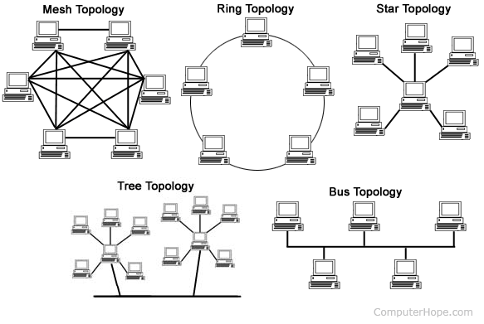
4.2. Networks Topology

Slide 34
4.3. Types of Networks
Local-area network (LAN) A network that connects a relatively small number of machines in a relatively close geographical area
Various configurations, called topologies, have been used to administer LANs
Ring topology A configuration that connects all nodes in a closed loop on which messages travel in one direction
Star topology A configuration that centers around one node to which all others are connected and through which all messages are sent
Bus topology All nodes are connected to a single communication line that carries messages in both directions
A bus technology called Ethernet has become the industry standard for local-area networks

Slide 35
4.3. Types of Networks CONTD…
Wide-area network (WAN)
A network that connects two or more local-area networks over a potentially large geographic distance.
Often one particular node on a LAN is set up to serve as a gateway to handle all communication going between that LAN and other networks
Communication between networks is called internetworking
The Internet, as we know it today, is essentially the ultimate wide-area network, spanning the entire globe
Metropolitan-area network (MAN)
The communication infrastructures that have been developed in and around large cities

Slide 36
So, who owns the Internet?
Well, nobody does. No single person or company owns the Internet or even controls it entirely.
As a wide-area network, it is made up of many smaller networks. These smaller networks are often owned and managed by a person or organization. The Internet, then, is really defined by how connections can be made between these networks.
Back

Slide 37
2-2 THE OSI MODEL
Established in 1947, the International Standards Organization (ISO) is a multinational body dedicated to worldwide agreement on international standards. An ISO standard that covers all aspects of network communications is the Open Systems Interconnection (OSI) model. It was first introduced in the late 1970s.

Slide 38
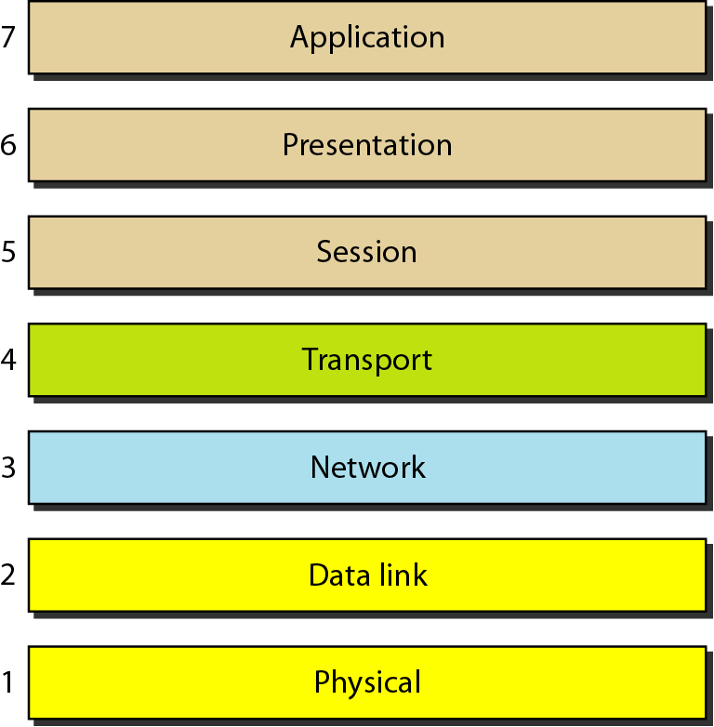
Figure Seven layers of the OSI model
Notes:
In developing the model, the designers distilled the process of transmitting data to its most fundamental elements. They identified which networking functions had related
uses and collected those functions into discrete groups that became the layers. Each layer defines a family of functions distinct from those of the other layers.
By defining and localizing functionality in this fashion, the designers created an architecture that is both comprehensive and flexible. Most importantly, the OSI model allows complete interoperability between otherwise incompatible systems.
Within a single machine, each layer calls upon the services of the layer just below it. Layer 3, for example, uses the services provided by layer 2 and provides services for
layer 4.
Between machines, layer x on one machine communicates with layer x on another machine. This communication is governed by an agreed-upon series of rules and conventions called protocols. The processes on each machine that communicate at a given layer are called peer-to-peer processes. Communication between machines is
therefore a peer-to-peer process using the protocols appropriate to a given layer.

Slide 39
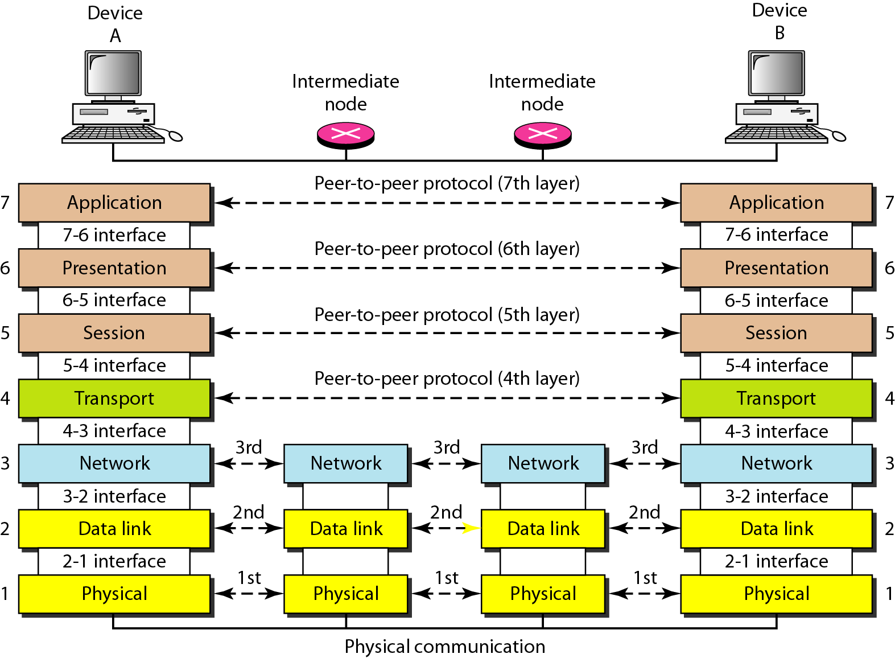
Figure The interaction between layers in the OSI model
Notes:
Peer-to-Peer Processes
At the physical layer, communication is direct: In Figure, device A sends a stream of bits to device B (through intermediate nodes). At the higher layers, however, communication must move down through the layers on device A, over to device B, and then back up through the layers.
Each layer in the sending device adds its own information to the message it receives from the layer just above it and passes the whole package to the layer just below it. At layer I the entire package is converted to a form that can be transmitted to the receiving device. At the receiving machine, the message is unwrapped layer by layer, with each process receiving and removing the data meant for it. For example, layer 2 removes the data meant for it, then passes the rest to layer 3. Layer 3 then removes the data meant for it and passes the rest to layer 4, and so on.
Interfaces Between Layers
The passing of the data and network information down through the layers of the sending device and back up through the layers of the receiving device is made possible by an interface between each pair of adjacent layers. Each interface defines the information and services a layer must provide for the layer above it. Well-defined interfaces and layer functions provide modularity to a network. As long as a layer provides the expected services to the layer above it, the specific implementation of its functions can be modified or replaced without requiring changes to the surrounding layers.
Organization of the Layers
The seven layers can be thought of as belonging to three subgroups. Layers I, 2, and 3-physical, data link, and network-are the network support layers; they deal with the physical aspects of moving data from one device to another (such as electrical specifications, physical connections, physical addressing, and transport timing and
reliability).
Layers 5, 6, and 7-session, presentation, and application-can be thought of as the user support layers; they allow interoperability among unrelated software systems.
Layer 4, the transport layer, links the two subgroups and ensures that what the lower layers have transmitted is in a form that the upper layers can use.
The upper OSI layers are almost always implemented in software; lower layers are a combination of hardware and software, except for the physical layer, which is mostly hardware.

Slide 40
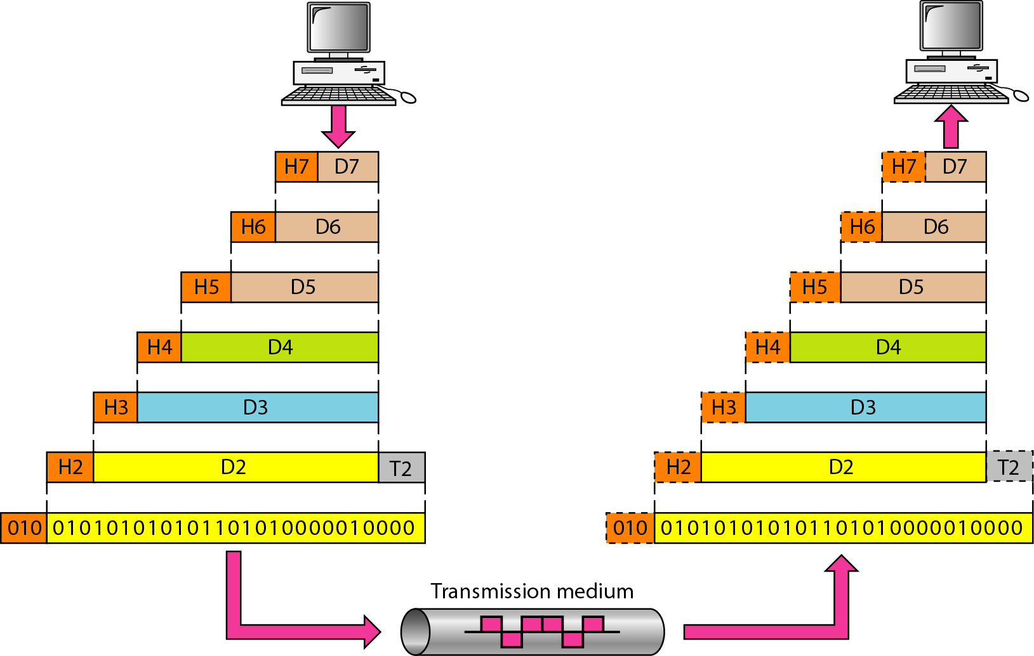
Figure An exchange using the OSI model
Notes:
In Figure ,which gives an overall view of the OSI layers, D7 means the data unit at layer 7, D6 means the data unit at layer 6, and so on. The process starts at layer 7 (the application layer), then moves from layer to layer in descending, sequential order. At each layer, a header, or possibly a trailer, can be added to the data unit.
Commonly, the trailer is added only at layer 2. When the formatted data unit passes through the physical layer (layer 1), it is changed into an electromagnetic signal and
transported along a physical link.
Upon reaching its destination, the signal passes into layer 1 and is transformed back into digital form. The data units then move back up through the OSI layers. As
each block of data reaches the next higher layer, the headers and trailers attached to it at the corresponding sending layer are removed, and actions appropriate to that layer are taken. By the time it reaches layer 7, the message is again in a form appropriate to the application and is made available to the recipient.
Encapsulation
Figure reveals another aspect of data communications in the OSI model: encapsulation.
A packet (header and data) at level 7 is encapsulated in a packet at level 6. The whole packet at level 6 is encapsulated in a packet at level 5, and so on.
In other words, the data portion of a packet at level N - 1 carries the whole packet (data and header and maybe trailer) from level N. The concept is called encapsulation; level N - 1 is not aware of which part of the encapsulated packet is data and which part is the header or trailer. For level N - 1, the whole packet coming from level N is treated as one integral unit.

Slide 41
